Slide 1

Medical Genomics: Spatial Transcriptomics
Y. Lim
Rare Cancers Genomics Team
November 25th 2024

Slide 2
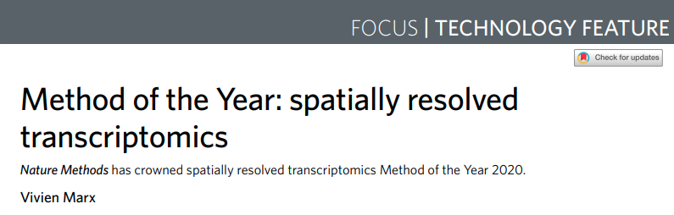
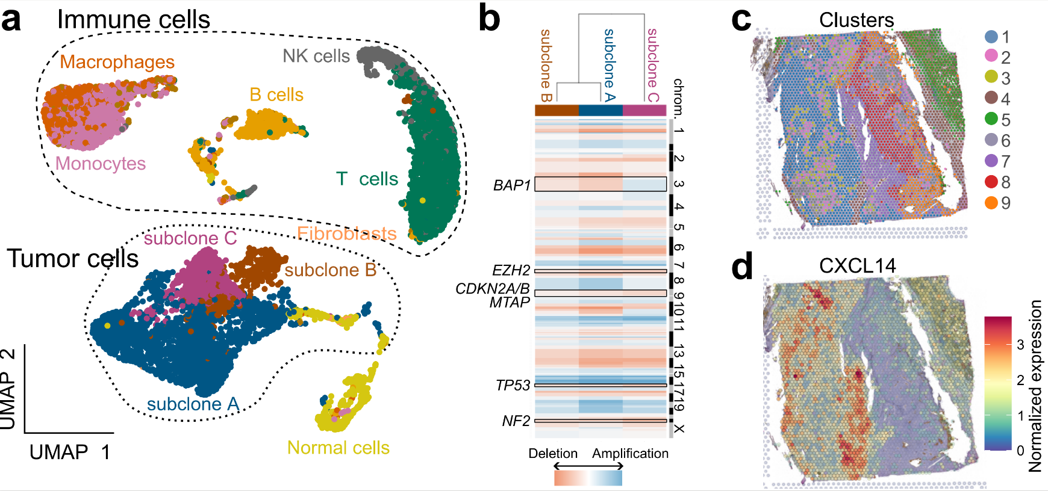
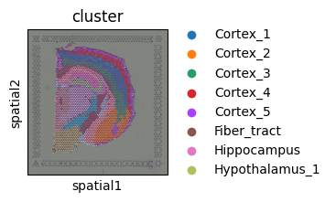
Spatial transcriptomics | Motivation
Bulk and single-cell sequencing →
transcriptomes of dissociated cells (removed from the tissue).
Spatial Transcriptomics technology:
Allows to keep spatial locations of the transcript → get spatial architecture of the gene expression and cell types localisation.
Application examples:
Study cell-cell communication (ex: between tumour and immune cells & stroma)
Identify spatial compartments within the tissue (ex: immune-accessible vs. immune-excluded tumour areas)

Slide 3
Spatial transcriptomics | Resources
Resources:
Yue L. et al. A guidebook of spatial transcriptomic technologies, data resources and analysis approaches. (2023),
SIB (Swiss Institute of Bioinformatics) course on YouTube (Spatial Transcriptomics Technologies - January 2025 (1 of 9)),
For practical details:
sc-best-practices project (26. Single-cell data resolved in space )
Squidpy tutorial (python) (Analyze Visium H&E data — squidpy documentation)
Seurat tutorial (R) (Analysis, visualization, and integration of spatial datasets with Seurat)

Slide 4
Spatial transcriptomics | Outline
Spatial transcriptomic technologies (principle, resolution, applications)
Image-based methods
Sequencing-based methods
Spatial data analysis (for sequencing-based data)
Pre-processing
Downstream analysis
Cell-cell communication (concept, inference, challenges)

Slide 5
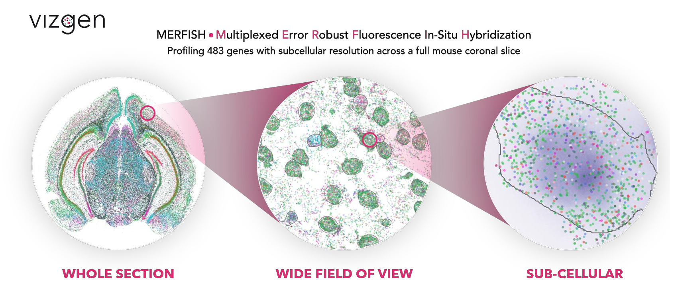
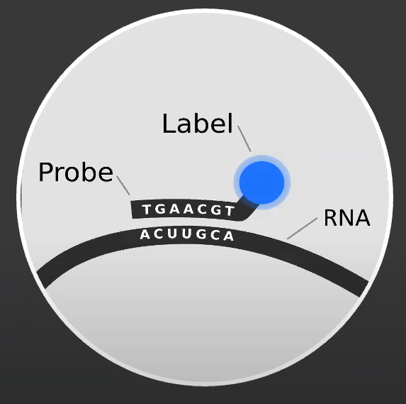
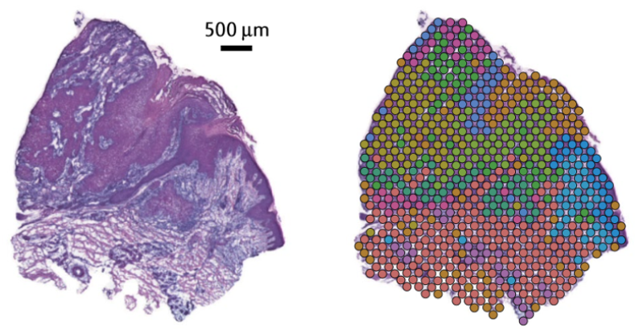
Spatial transcriptomics | Technologies
Image-based technologies
Sequencing-based technologies
In-situ hybridization (ISH)
In-situ sequencing (ISS)
NGS-based (Spatial Sequencing)
Spatial tagging
Targeted approach + super-resolution microscopy
Spots of microarrays to capture RNA + NGS
Limited number of genes
Subcellular resolution (single RNA molecules)
Whole transcriptome sequencing
Lower resolution
Notes:
An overview of single-cell RNA sequencing and spatial transcriptomics

Slide 6
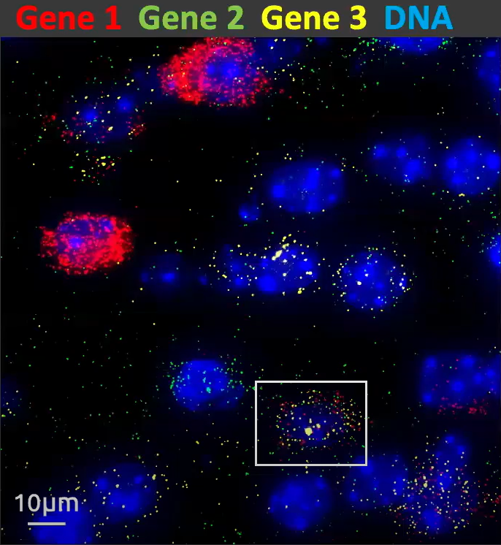
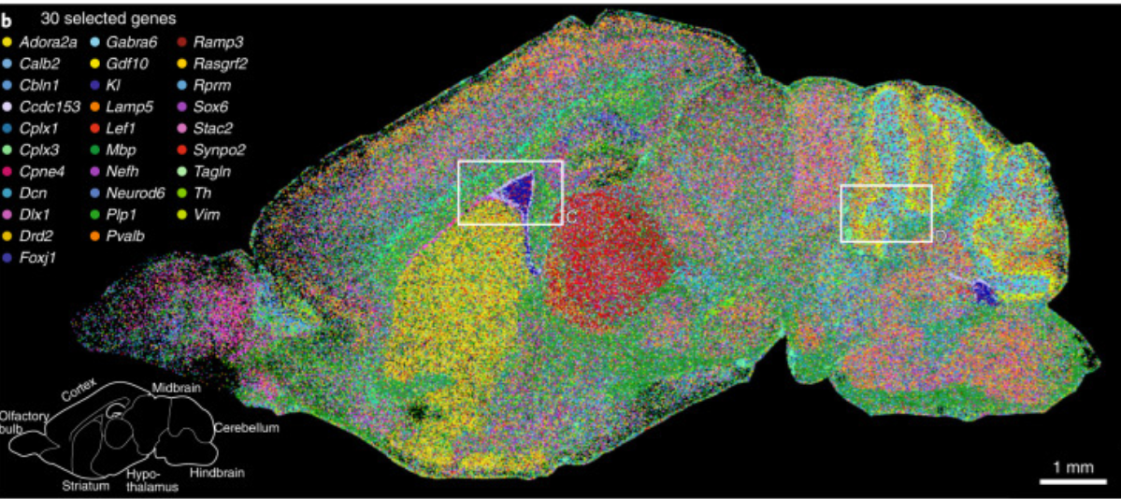
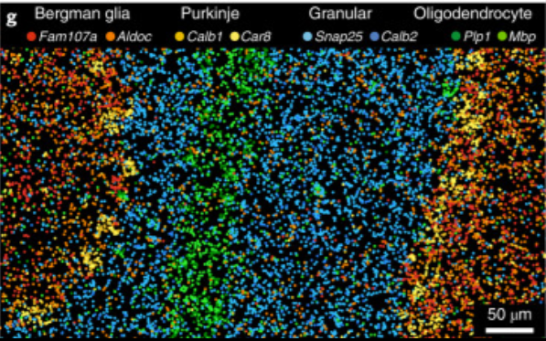
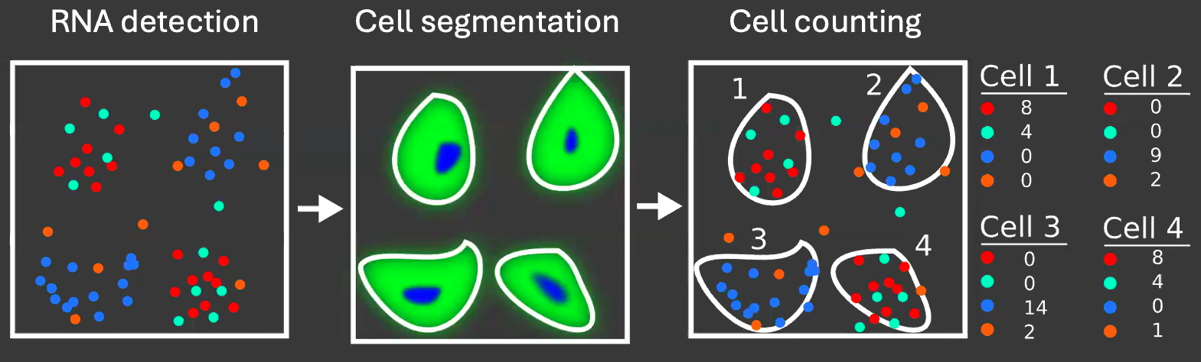
Spatial transcriptomics | Techniques
Borm et al. 2023 Nat. Biotech
In-situ hybridization
MERFISH
Fluorescent probes bind specific RNA molecules directly in the tissue. (FISH-like methods)
Limitation by the number of colours observable in a microscope → repeat the procedure in cycles (multiplex FISH).
More advanced technologies:
MERFISH (Multiplexed error-robust FISH)
Xenium (10X Genomics)
CosMx SMI (NanoString)
Cell segmentation challenge

Slide 7
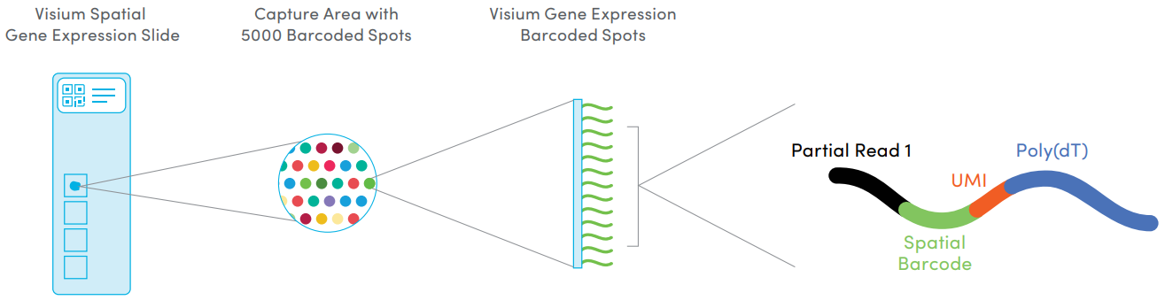
Part III. Spatial transcriptomics | Techniques
Spatial Sequencing: 10x Genomics Visium
Fresh-frozen tissue section placed on array with capture probes that bind to RNA (poly A tail)
cDNA is synthesized (RT) from captured RNA and sequencing libraries prepared
Libraries are sequenced. Reads have spatial barcode + UMI.
Spatial composition of the Visium Spatial Gene Expression slide. Each slide contains four Capture Areas with approximately 5000 barcoded spots, which in turn contain millions of spatially-barcoded capture oligonucleotides. Tissue mRNA is released and binds to the barcoded oligos, enabling capture of gene expression information. Source: 10X genomics.

Slide 8
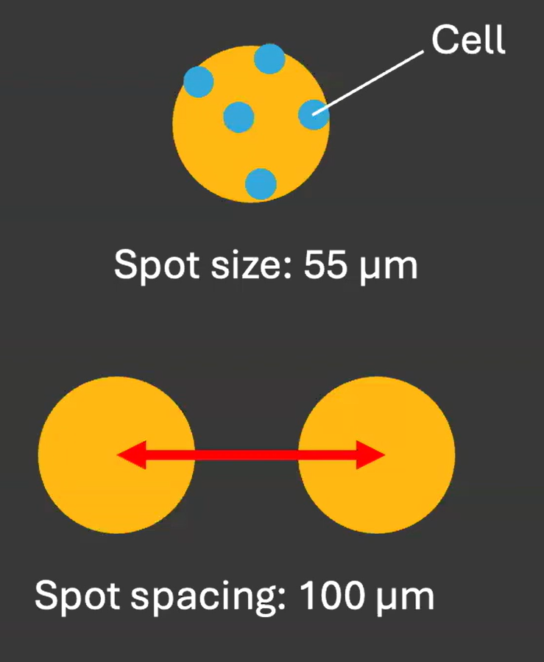
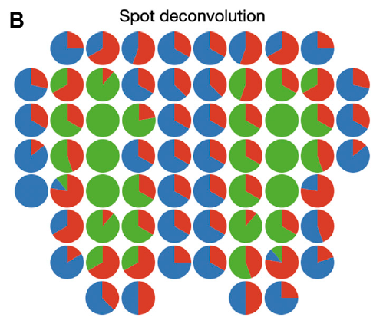
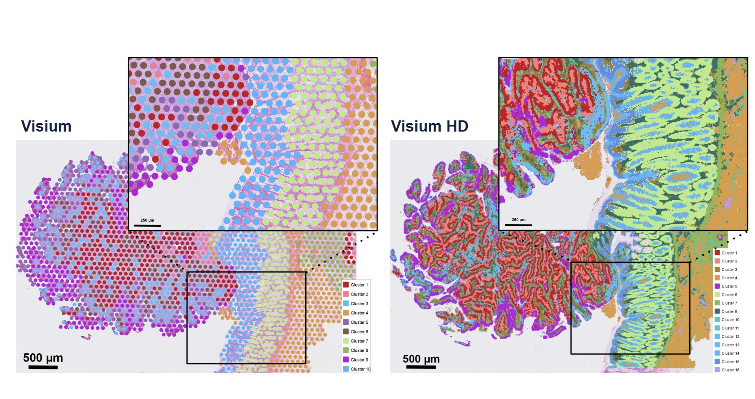
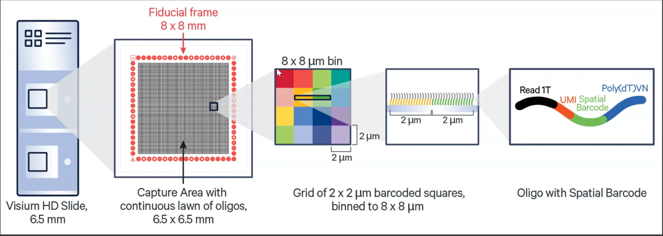
Spatial transcriptomics | Techniques
10X Visium resolution:
Spot ≈ 55 microns -> up to 10 cells per spot
Sample ≈ 5000 spots
Deconvolution challenge
10X Visium HD
spot ≈ 2 µm → ~1 (or <1) cell per “mini‐spot”;
sample ≈ 11,000,000 spots
Spot Deconvolution
Still not a single-cell resolution, as one cell may overlap with multiple spots.

Slide 9
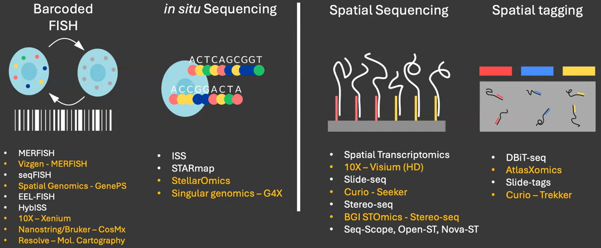
Spatial transcriptomics | Techniques
Image-based methods
Sequencing-based methods
Hypothesis testing
Subcellular structure
Exploration

Slide 10
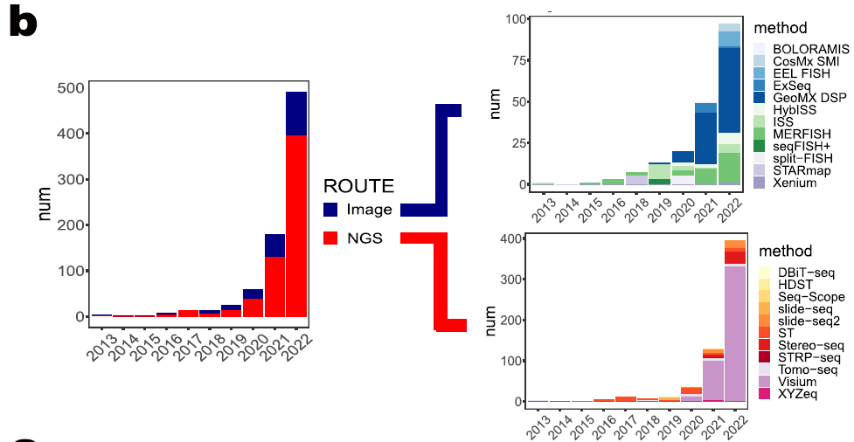
Spatial transcriptomics | Techniques
Number of articles issued for different techniques
L. Yue et. al, A guidebook of spatial transcriptomic technologies, data resources and analysis approaches.

Slide 11
Questions?

Slide 12
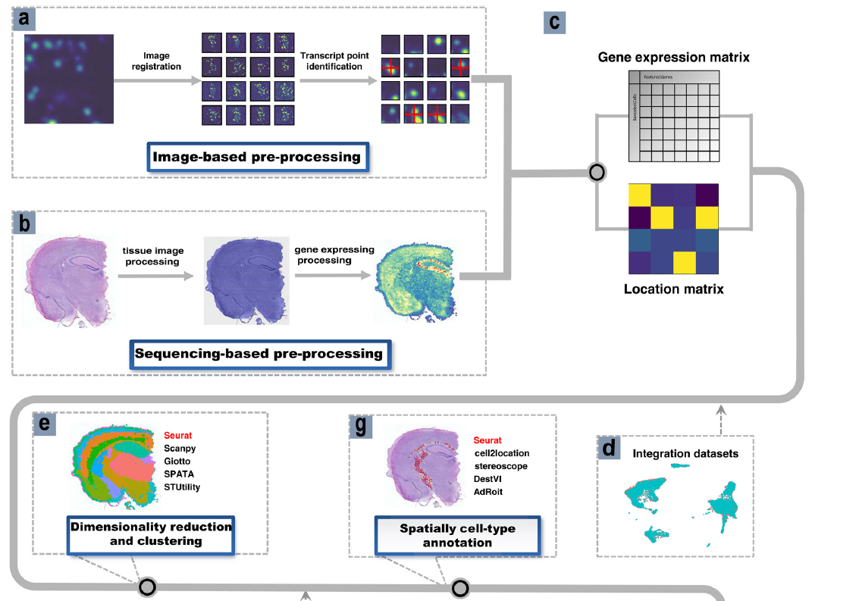
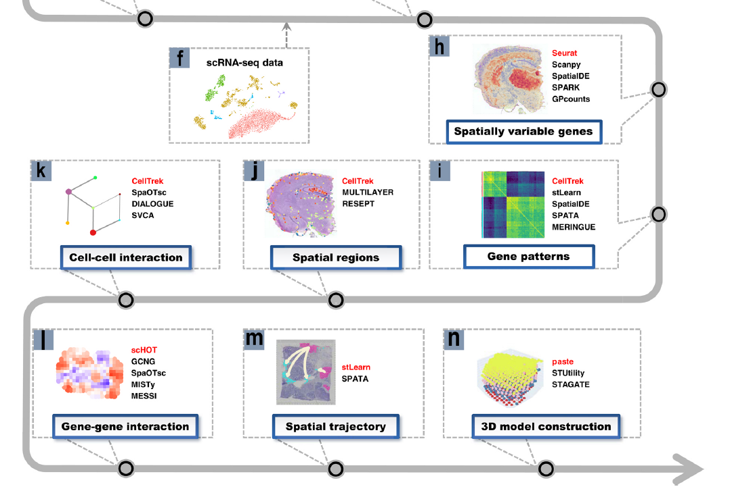
Spatial transcriptomics | Analysis
L. Yue et. al, A guidebook of spatial transcriptomic technologies, data resources and analysis approaches.

Slide 13
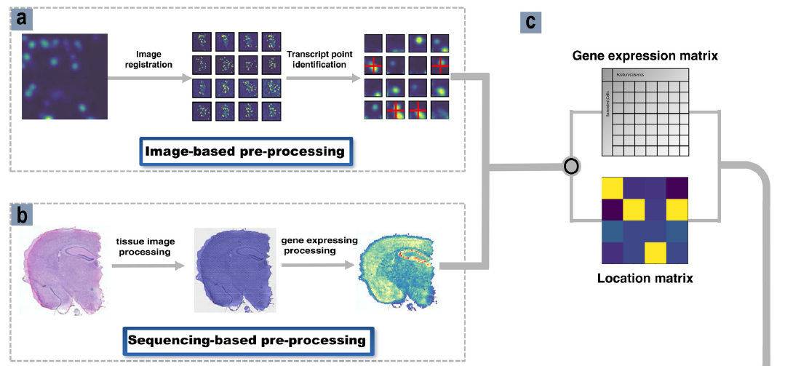
Spatial transcriptomics | Analysis
Pre-processing
Goal: generate a well-prepared gene expression matrix and location index matrix, which serves as the starting point for the downstream analysis.
Preprocessing steps (for Visium):
1. Tissue (H&E) image processing:
Detect tissue vs. background
Align the spot grid to the image → spot location matrix
2. Gene expression processing:
sequenced reads filtering and alignment → gene expression
3. Integration of gene expression and tissue images →
Spot × Gene matrix.
For 10X Visium: SpaceRanger performs all the pre-processing steps.
Notes:
Message: all the possible processing steps after the pre-processing are optional and depend on the requirements of the methods used.

Slide 14
Spatial transcriptomics | Analysis
Processing
Depending on the application. No one-fits-all strategy.
Quality control (QC), filtering
Normalisation and scaling
Feature selection
Dimensionality reduction
Clustering

Slide 15
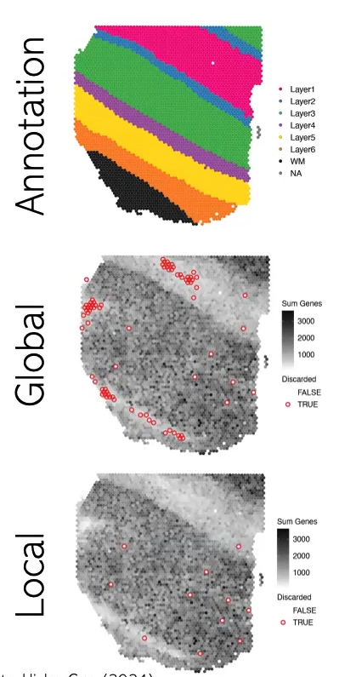
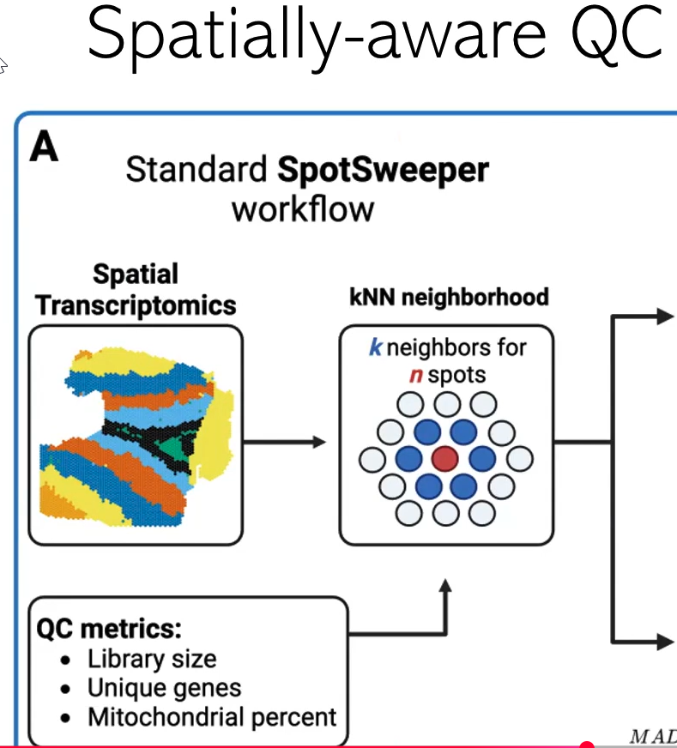
Spatial transcriptomics | Analysis
Quality Control
The QC threshold applied based on the spot neighbourhood → identification of local outliers vs global outliers.
Result in:
Removing less spots
Removing spots more uniformly over the slide
Note: In spatial data we can always visualise low-quality cells, determine their location/patterns might be useful.

Slide 16
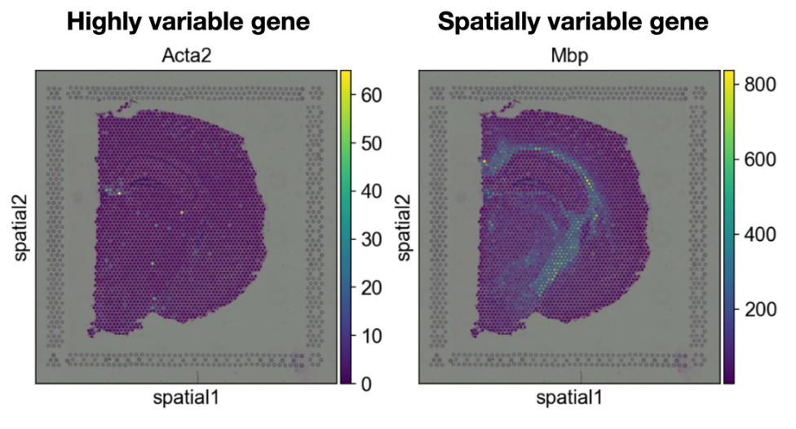
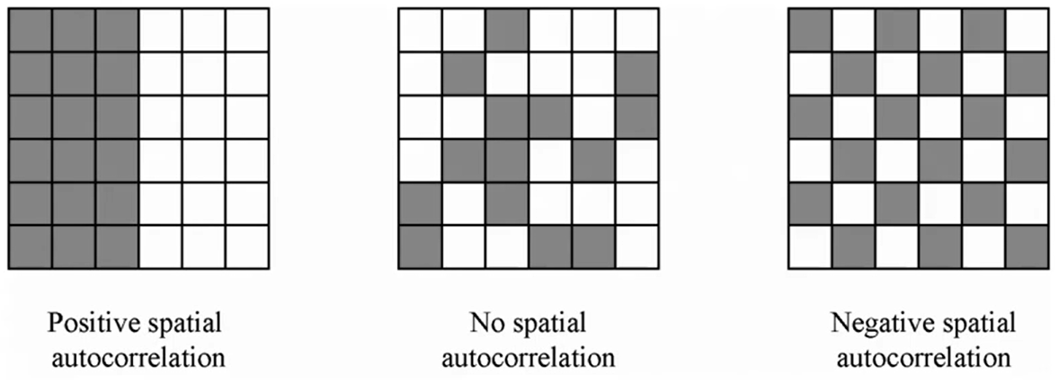
Spatial transcriptomics | Analysis
Feature selection: Spatially variable genes (SVG) vs. Highly variable genes (HVG)
Motivation: Genes with spatial expression pattern might reveal niche-specific gene programs.
SVGs are genes with a highly spatially correlated pattern of expression.
Methods: squidpy, SpatialDE, SpaGCN, Giotto, …
Statistical measures of spatial autocorrelation:
Moran’s I
Geary’s C
Local Moran’s I (LISA)
Moran’s R
…
Spatial RNA-seq of a lung neuroendocrine tumor. c. molecular clusters. Source: lungNENomics project, N. Alcala WCR grant application.

Slide 17
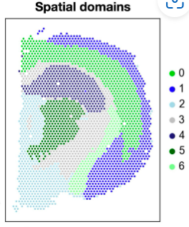
Part III. Spatial transcriptomics | Analysis
Single-cell best practices guide (Nat Rev Genet; 2023) -> different methods, python code
Downstream analysis
Neighbourhood analysis: study enrichment of cell types in specific regions of the tissue (local analysis)
Spatial domains: identify spatial patterns in tissue: define larger functional or anatomical regions
Spot deconvolution: assign proportions of cell types to each spatial location using a single-cell reference
Cell-cell communication inference: identify ligand-receptor interactions, signalling pathways, communication patterns across cell types.
Source: www.sc-best-practices.org

Slide 18
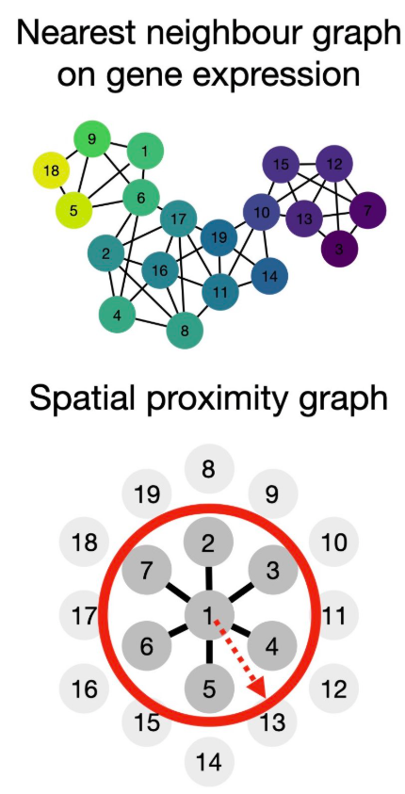
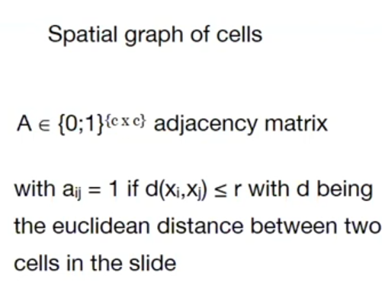
Spatial transcriptomics | Analysis
Sequencing-based technologies
Neighbourhood analysis
scRNA-seq analysis: gene expression proximity
ST: gene expression proximity + spatial proximity
Notes:
Using spatial gene expression data (instead of color staining) to identify regions of tissue that correspond to biological structures — like tumor vs stroma vs immune regions — just as histology does visually.

Slide 19
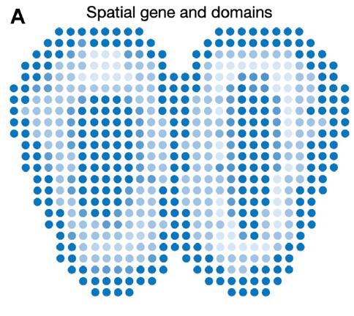
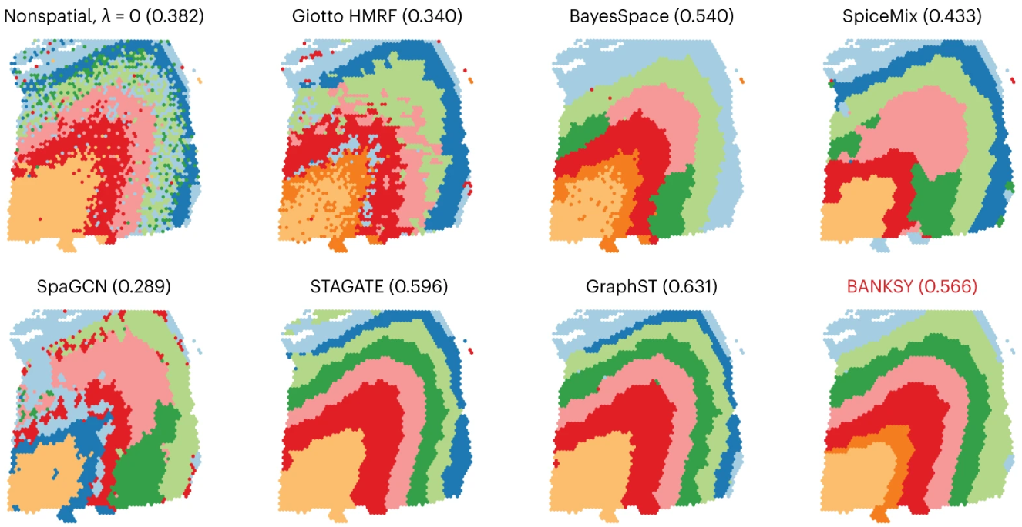
Spatial transcriptomics | Analysis
Spatial domains
Spatial domains group nearby spots with similar gene expression into meaningful tissue regions.
Needed for downstream analysis (CCC)
Traditional methods: Louvain clustering, Leiden clustering, k-means clustering, hierarchical clustering, Gaussian mixture models.
More sophisticated algorithms: SC-MEB, BayesSpace, SpaGCN - graph convolutional network based approach, DR-SC (HMRF)
Singhal, V., Chou, N., Lee, J. et al. BANKSY unifies cell typing and tissue domain segmentation for scalable spatial omics data analysis. Nat Genet (2024).
Notes:
Using spatial gene expression data (instead of color staining) to identify regions of tissue that correspond to biological structures — like tumor vs stroma vs immune regions — just as histology does visually.

Slide 20
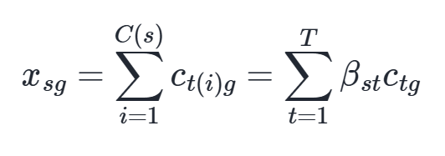
Spatial transcriptomics | Analysis
Cell-type annotation & Integration with scRNA-seq
Motivation: cell-type architecture of the tissue, inference of signalling between cells.
Deconvolution – predict proportions of cell types in each spot based on signature genes expression for each cell type (computed from sc reference data)
Inverse problem:
Gene g expression in spot s
Proportion of cells of type t in spot s
Signature expression of gene g in a cell type t.

Slide 21
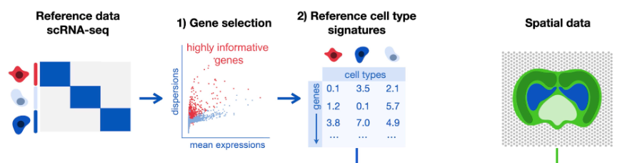
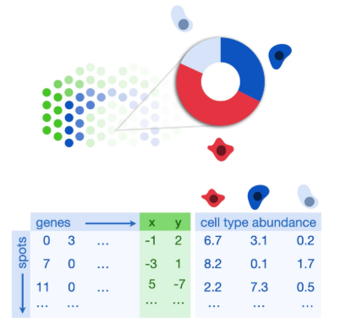
Spatial transcriptomics | Analysis
Deconvolution (Cell2location)
Cell type mapping
Source: www.sc-best-practices.org

Slide 22
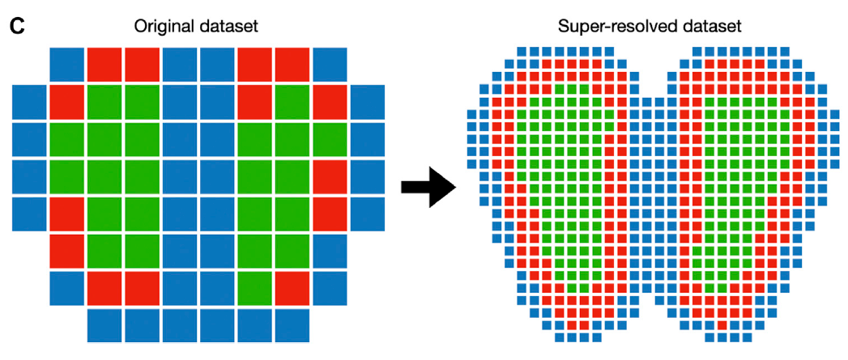
Spatial transcriptomics | Analysis
Integration with scRNA-seq and cell-type annotation
Cell-type assignment:
Assign dominant cell type for each spot (above a threshold)
Multi-assignment: all cell types with proportions above a threshold
Using optimal transport (Tangram, SpOTsc)
Spatial smoothness (stLearn, SpaGCN, …)
Increasing the resolution: approach single-cell resolution (ex. BayesSpace)

Slide 23
Questions?

Slide 24
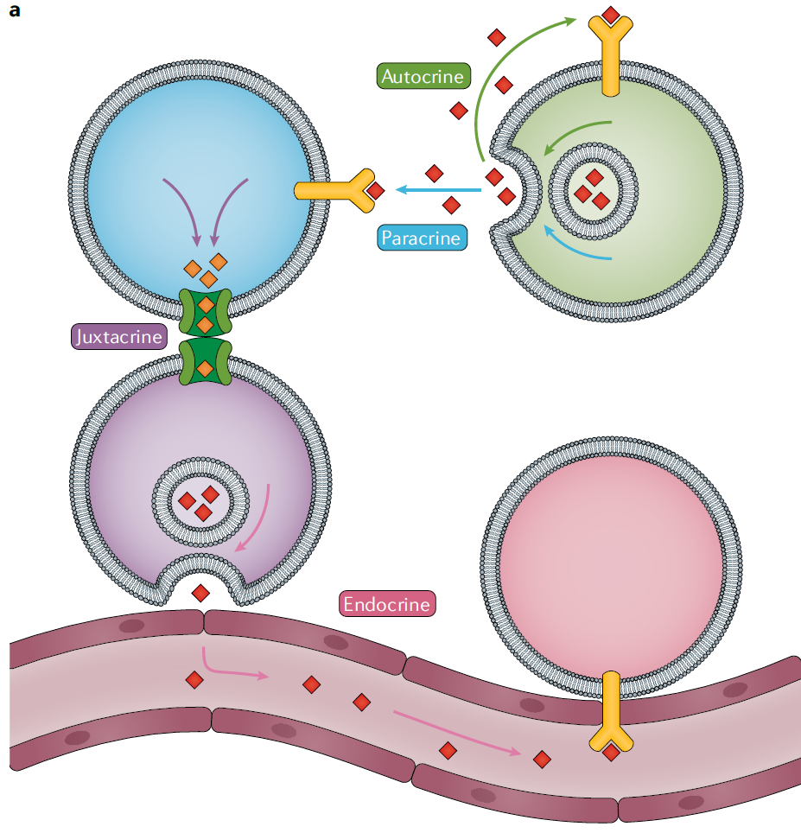
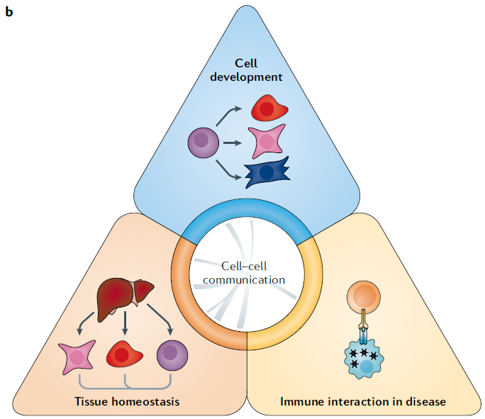
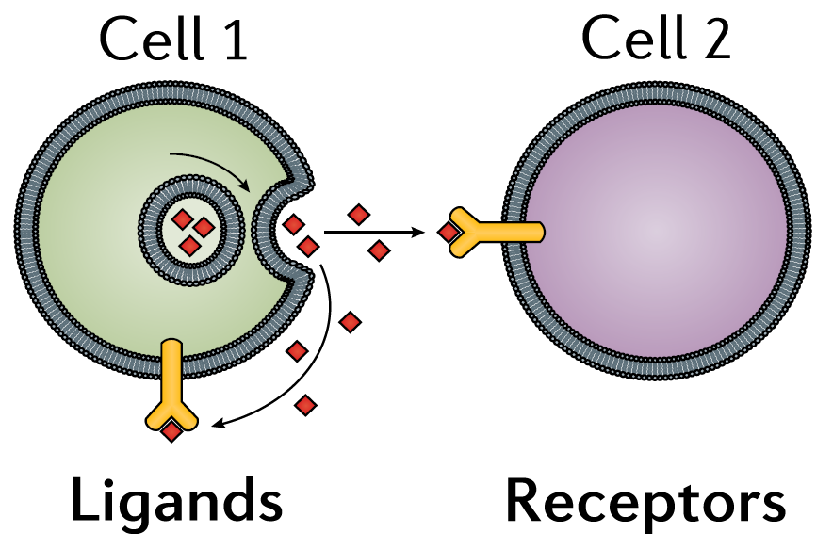
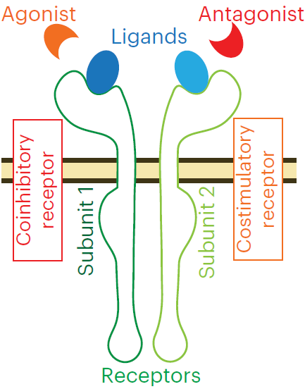
Cell-cell communication
Types of signalling
Coordinating activities
Ligand – receptor interaction
Motivation
Understanding disease-related molecular mechanisms
Identifying targetable pathways/interactions
Armingol, E. et al. Deciphering cell-cell interactions and communication from gene expression. Nat Rev Genet. 2021
Notes:
1. In multicellular organisms cell communication is essential for maintaining the major activities, like cell development, immune responses, and tissue functioning.
2. The main mechanism of cell communication is ligand-receptor interaction, when ligand proteins secreted by one cell are recognized by the receptor proteins expressed on the surface of the other cell.
3. Sometimes the signalling mechanism can be quite sophisticated and depends on multiple molecules, for instance the receptors and the ligands may consist of multiple pieces and depend on the expression of co-receptors and other activating or inhibiting molecules.

Slide 25
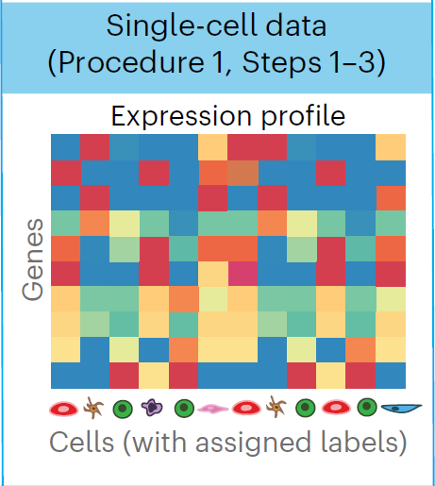
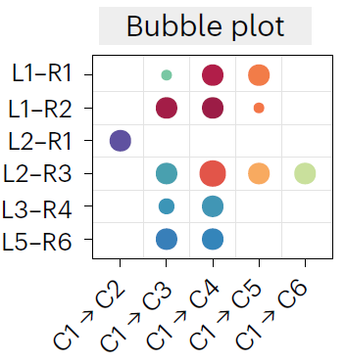
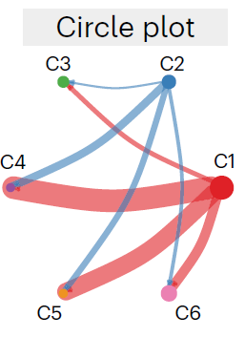



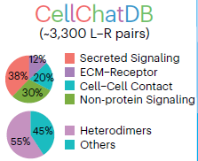


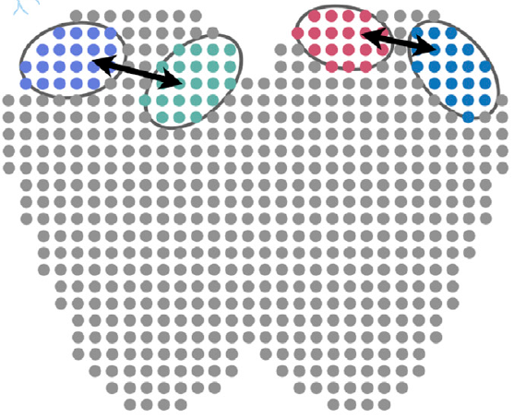


Inference of cell-cell interactions
CCI Inference
=
Computational Method
+
Database of known ligand-receptor interactions
Transcriptomics data
Inferred interactions
Score LR interactions over pairs of cell groups
(method)
L-R interactions
+
Cell group pairs
L-R database
CCI network
Spatial data
Armingol, E. et al. Nat Rev Genet. 2021
1. Filter out distant interactions
2. Scale scores by distance
Notes:
All CCI inference tools are a combination of a computational method that predicts significant interactions and a ligand-receptor database, containing the known ligand-receptor interactions (that should be constantly curated and updated).
The standard pipeline of the CCI methods is the following. As an input an algorithm takes a transcriptomic dataset (usually single cell count matrix) with annotations for cell types or cell groups. So, each spot or cell should have a specific label. This dataset is filtered to include only genes that are present in the LR database, only signalling genes are considered for the further analysis.
Then, for each known ligand-receptor pair in our data and each couple of cell groups the algorithm computes a score that represents the likelihood that this LR interaction happens between these particular cell groups. The score is usually a function of the co-expression of the ligand in the first cell group and the receptor in the second cell group.
As an output the algorithm returns a list of identified significant interactions for each pair of cell groups. From this table a full CCI network can be obtained by summing up all the interactions for each pair of cell groups.
One of the major problems of the inference methods is the abundance of false positive predictions.
To address this issue the spatial information about the data can be used. As the cell-cell interactions physically may not happen between distant cells, and the further the cells are the less likely the interaction becomes, the two ways in which we can use the spatial data is to filter out distant interactions and to scale the interaction scores accordingly to the distance between cells.
6. As in our case we do not have single cell resolution, but have spatial information, it is particularly interesting to make the best use of this spatial component.

Slide 26
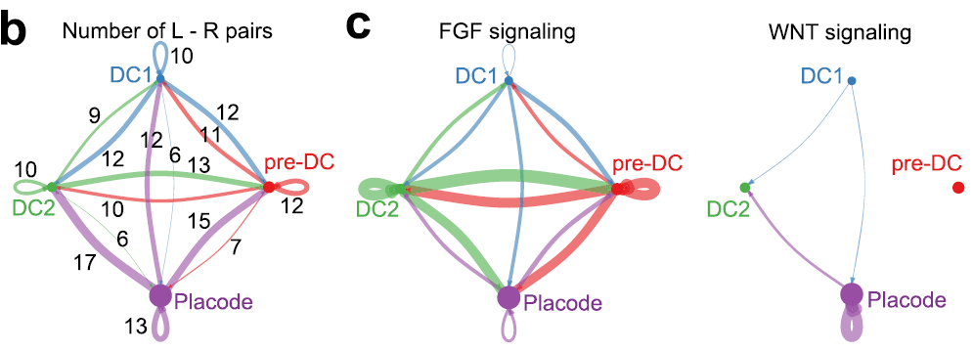
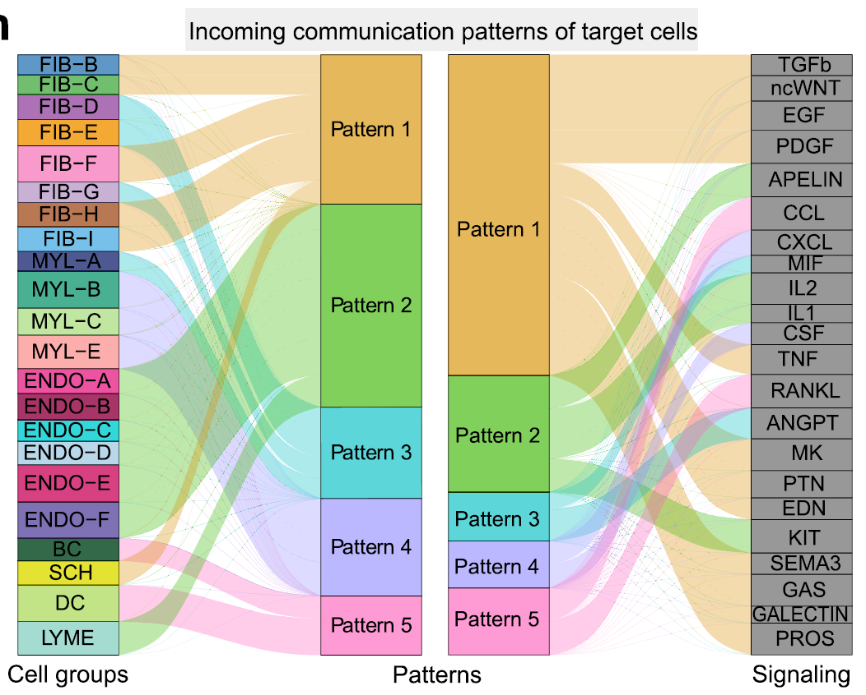
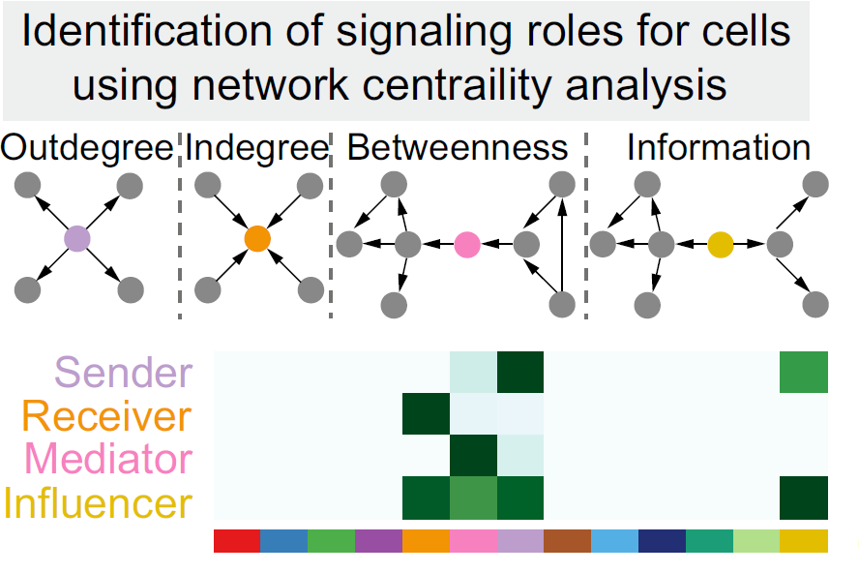
Interpretation of CCI output
Visualise networks (total/by signalling pathway/by specific interaction).
Identify communication patterns.
Identify signalling roles.
Jin, S. et al. Inference and analysis of cell-cell communication using CellChat. Nat Commun, (2021).

Slide 27
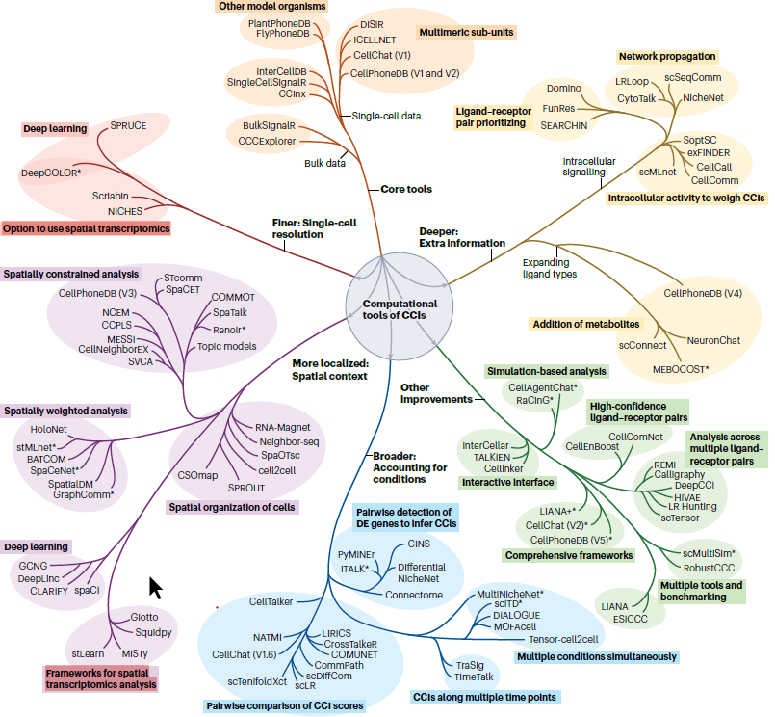
Variety of inference methods
LIANA+
Armingol, E., Baghdassarian, H.M. & Lewis, N.E. The diversification of methods for studying cell–cell interactions and communication. Nat Rev Genet 25, 381–400 (2024)

Slide 28
Main CCC inference challenges
High false-positive discovery rates
Approach: add distant constraints from spatially-resolved data, consensus of different methods
Low consensus over different methods and resources
Difficult to validate the results (no ground truth available)
Approach: Leverage the downstream signalling and compare with data
Difficult to distinguish simple co-expression and actual CCC events

Slide 29
Thank you
Y.Lim
Rare Cancers Genomics Team
November 25th 2025

